Slide 1
Images and Convolutional Networks

Slide 2
Housekeeping
Today – Convolutional Neural Networks and Images in 2+ Dimensions.
(Roughly ch5, though the generator part in the text is outdated – we use datasets).
Convolution and pooling.
Kernels and filter maps.
More complex networks.
Workbook #024 – some stuff will take a while to run, you may want to run the file or solution file in colab and let it sit.
There are some variables for epochs, batches, and such near the top.

Slide 3
Detour 1 – Sequential vs Functional
Sequential models work sequentially – one layer after the other.
Start with an input layer. End with an output
Functional neural network types allow for that rule to be broken:
Slicing and concatenating parts of a model.
Multiple inputs and/or multiple outputs.
Image processing – examine different portions of an image differently.
Generally allows for task specific adaptation of the model to the data.
Imagine stock price predictions:
Multiple inputs for book info, market analysis, and time-series of tech. info.
Output of price projection and buy/sell/hold recommendation.

Slide 4
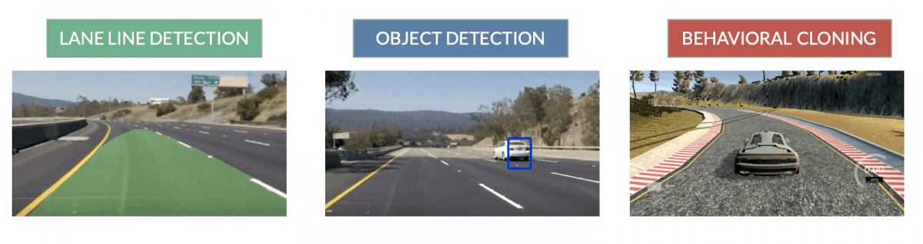
Detour 1 - Functional Models
Functional models allow for flexibility in the structure of the network.
Imagine a self driving car, and a model that generates the action to take.
Segment the image into foreground and background.
Foreground processing:
Identify object in front.
Determine if it is moving.
Background processing:
Identify lane boundaries.
Identify stop light signals.
Combine results:
If a car is in front of us, it is moving, and light is green, maintain speed.
If a car is in front of us, it is just starting to move, light is green, slow down.
If a toddler is in front of us, it is walking, light is green, stop.

Slide 5
Detour 2 - Loss Measures
Cross entropy is the most common way to measure classification losses.
Binary cross-entropy:
Used when we have a true/false classification.
Categorical cross-entropy:
Used when we have a multiclass classification.
Assumes y values are 1-hot - i.e. output of the “to_categortical” function.
Sparse categorical cross-entropy:
Used when we have a multiclass classification.
Assumes y values are integers.
Categorical and sparse are separated by the encoding of the target. Easy to confuse.

Slide 6
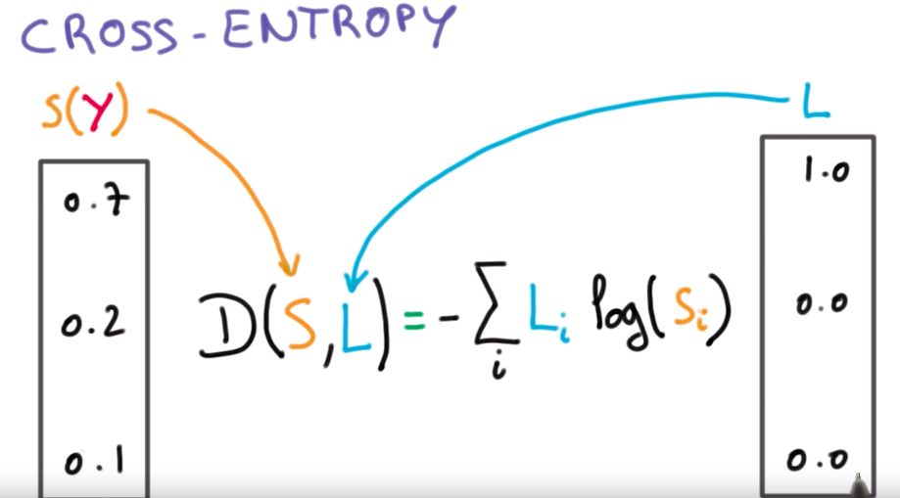
Detour 2 - Cross-Entropy
Cross entropy measures how close our prediction is to the true class.
More specifically, how close our confidence was to the real class.

Slide 8
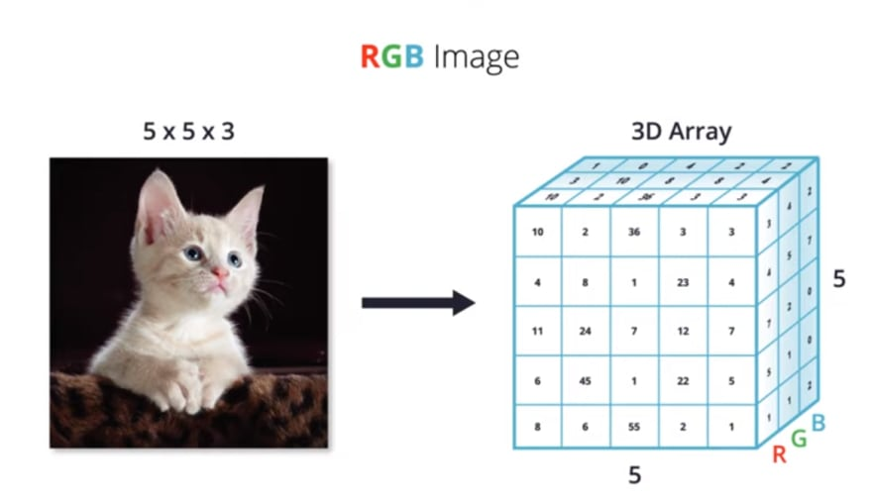
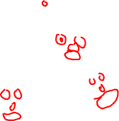
Image Basics
Images and image recognition is more simple than it appears:
Images are an array of pixels.
E.g. a 1080p image is 1920 x 1080 pixels. (greyscale)
Color images are the same, just slightly more complex:
Rather than a depth of 1 color, color images have a depth of (normally) 3.
Red, Green, and Blue are each a layer.
E.g. a 1080p image is 1920 x 1080 x 3 – one layer per color.

Slide 9
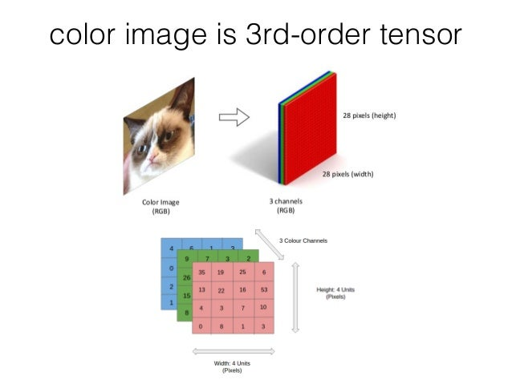

Slide 10
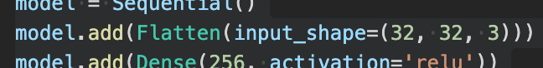
Images in Neural Networks
We can adapt our Keras based models to 3D images relatively easily.
We still (for now) want to flatten the image into a 1D array.
The flattening can happen in a layer – Flatten.
Recall – input shape is one record, for us an image.
Flatten will auto-flatten it down, so we don’t need to worry more about it.
From here, we can proceed as we are used to.
E.g. img_size_pixels = 32 * 32 * 3.
Output of the flatten layer is a grid of N records by 3072 pixels wide.

Slide 11
Images in Neural Networks
Image recognition is one of the big leaders in modern neural networks.
Can be far more accurate, especially in big data.
Images have spatial relationships not well represented in linear arrays:
E.g. a bike has two wheels, and a triangle in between.
It doesn’t matter where in an image this object is, only the location relative each other.
Convolutional neural networks are able to examine images in a way that captures spatial relationships.
The deep networks from last time that do well at image recognition are CNNs.

Slide 12
Convolutional Neural Networks (CNN)
A CNN is a different variation of neural network that does well with images.
Until now we’ve used “standard” dense neural networks. Feed-forward.
CNN is based on the concept of “convolution”, a mathematical technique:
Convolution is a mathematical operation on two functions that produces a third function that expresses how the shape of one is modified by the other.
For our purposes CNN has a small window (kernel/filter) that looks at one section of an image (e.g. 3 x 3), transforms that for an output, and slides pixel by pixel (stride) over the entire image.
Convoluted definition, simple idea to visualize…

Slide 13
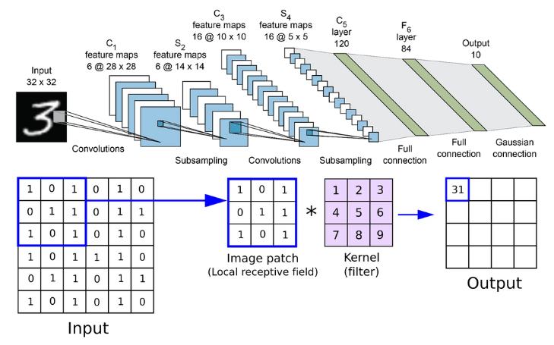

Slide 14
Note on Image Shapes
NNs don’t inherently require square images to work, but they do need a specific size.
The math of all those matrices requires an image of a certain size.
Every dimension must be fixed for the operations to work between layers.
This could theoretically be rectangle, it just usually isn’t.
‘Published’ models may be able to handle different sizes in practice through preprocessing.
Clip out a portion of a predefined size.
Enlarge or buffer an image to a predefined size.
Resize an image to different dimensions.

Slide 15
BUT First… Basic CNN Parts
CNN have different types of layers than the Dense we are used to:
Convolutional layers – do the convolution step just mentioned.
Pooling Layers
“Normal” neural network layers – take the data processed by the convolutional parts and do a “standard” prediction.
First, we’ll look at the convolutional layer part.
Simple parts:
The stride is how many pixels the filter slides, we have 1 in the example.
The filter/kernel size is the dimension of the pixels being looked at.

Slide 16
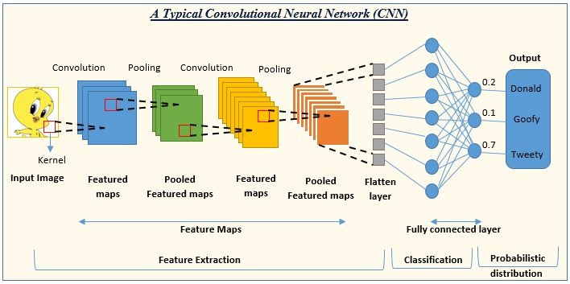

Slide 17
Stop Being so Convoluted!
Convolutional neural networks are able to capture spatial relationships in data.
I.e. where certain features (pixels) are in relationship to others.
Rather than processing the data as a set of features, CNNs take 2D ‘windows’.
This means that an area of an image can be represented in the translated data.
For example, the model can “see” an edge of a lane or a face, irrespective of the exact features (pixels) that make it up.
The initial layers of a CNN translate the images into features, using these 2D windows.
Those features are eventually fed into a regular network for final prediction.
The flattening is after most processing, not at the beginning.

Slide 18
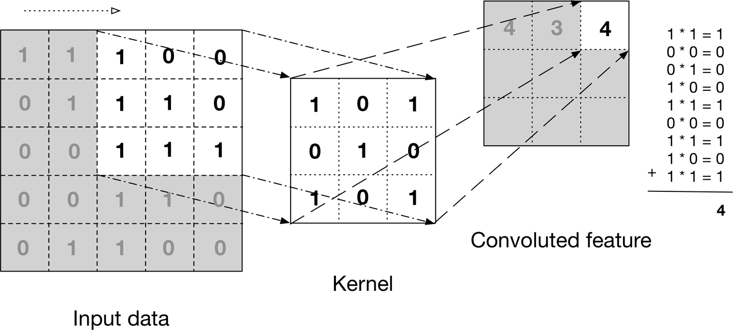

Slide 19


Slide 20
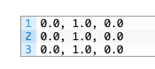
What is Happening?
The filter or kernel looks at each tiny “window” of the image.
The data is transformed through the filter into the output.
This process is able to identify patterns in the data:
In image data, those patterns correspond to features – edges, lines, shapes, etc…
For example, a 3 x 3 filter that can “see” vertical lines:
If a vertical line is in the image it will have data that is vertical.
When transformed, that data get’s “weighted”. The weights are learned.
Multiplied by the 1s, not the 0s.
Things that have vertical lines “get transferred” to the next layer.
The network can “see” those lines as features.

Slide 21
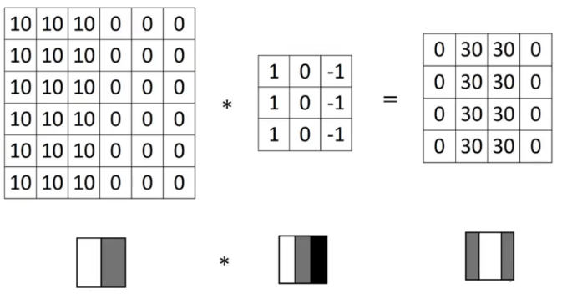
Edge Detection
Taking the vertical line example a bit further, here’s a real type of filter.
In images, higher value = more white, lower = black.
Note: in the first convolutional layer we have one set of kernels per ‘channel’ of z-dim.
Each filter only acts on one layer.

Slide 22
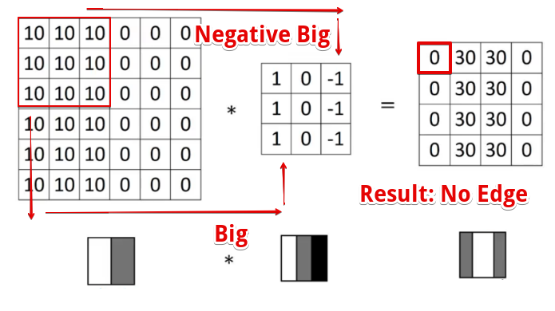
First Slice
Top left 9 pixels are multiplied by the filter and added.
All pixels are white (big number) so they end up cancelling each other.

Slide 23
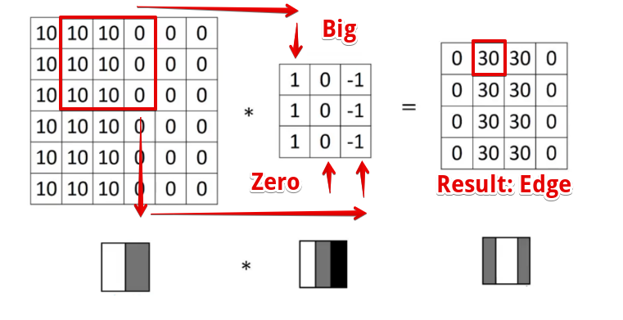
Second Slice
Range of window slides 1 pixel (stride length) to the right.
Left pixels are white (big number), right pixels are black (small number).
When added this means all except left are 0, so we have a big number as a result.
We found an edge!!
The output ”sees” vertical edges.

Slide 24
Keep Slicing….
We repeat this across every window the filter can sit over.
Every filter does this same thing.
There can be dozens or hundreds per layer.
Each learns to ‘see’ something different.
The weights will be adjusted to what ‘works’ – lowest loss.
The filters end up as each detecting something useful for whatever the output is.

Slide 25


Slide 26
Filters in Practice
Like other layers in a NN, the filters in a convolutional layer learn during fitting.
Each filter learns to identify some aspect of the image.
E.g. a model trained to differentiate cars from trucks might identify the horizontal rectangle shape of a truck bed. Another filter might recognize the slope of a car rear window.
What filters ‘see’ need not be human readable, but the idea is identical to seeing lines, circles, etc…
The convolutional filters have a couple of key benefits for image processing.
Translation invariant – patterns (edges, curves, etc…) can be found anywhere, once identified.
Hierarchical – the layered representations allow real world things in images to be composed of smaller items. A face is made up of eyes, nose, and mouth, all smeared on an oval.
This type of model tends to work better on images, due to the spatial relationships learned in the kernels.

Slide 27
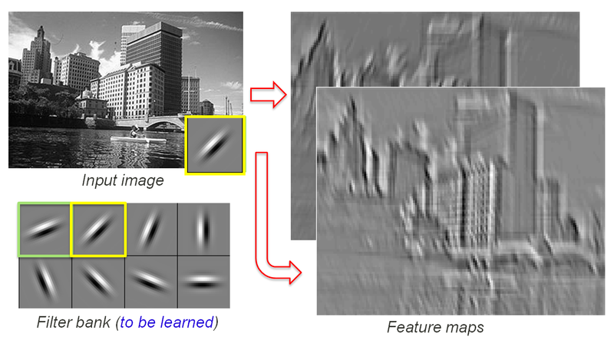

Slide 28
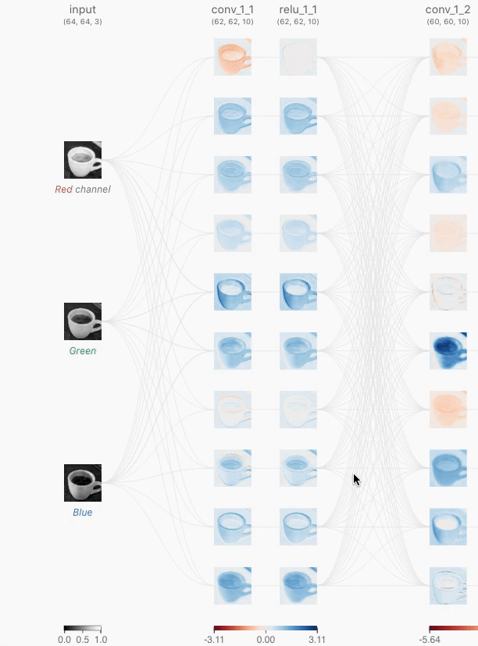

Slide 30
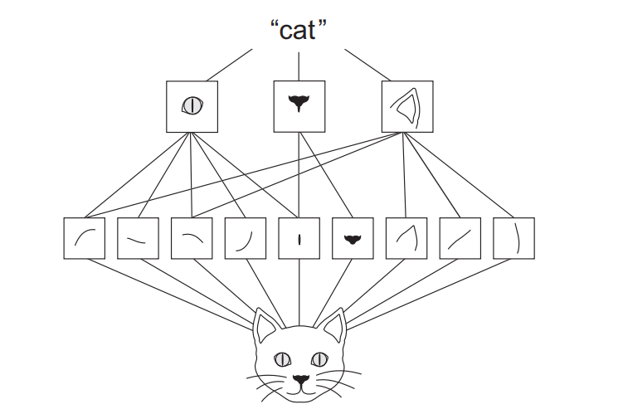

Slide 31
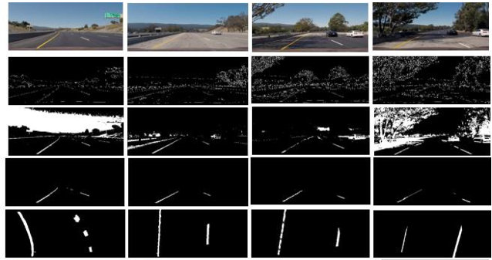
Example – Self Driving Car
You can build a self driving car that will stay between lanes using a mini-PC.
Car is controlled by a model that takes in images and outputs control signals.
Simplified version that only returned a turn amount to stay in lane.
The filters in the convolutional layers would learn to do edge detection.
The loss is “did it stay in lane”, so the model tries to minimize it.
The weights that trained via BP are the things defining the filters.
The filters that can detect edges are likely to have the lowest loss attributed to them. The ones that don’t have more.
The model will learn in that direction: detect edge->stay in lane->less loss. And the inverse, less lane-y things likely have more loss.
The feature maps are shown here.
If it can be expressed in inputs and loss, a neural network can predict it.

Slide 32
Pooling
The other new type of layer is a pooling layer.
Pooling layers “down sample” the images passed to them.
I.e. Reduces the resolution of the image.
Reduces amount of data to process, which can be large.
Makes features seen in the convolutional layer more generalizable:
E.g. every edge won’t look exactly the same, but they’ll resemble each other.
Intuitively, think of a sharp images of two people, it is easy to differentiate them. Now think of blurrier pictures (e.g. they are in the background of a photo) – the differences fade and they look more similar.
The above is the goal – identify edges, circles, head shapes, etc… in their general form.
We start with a bazillion features, we end with a few(-ish) classes, these funnel…

Slide 33
Pooling
Pooling down samples, or transforms the data into a lower pixel representation.
Reduces the resolution (# of pixels) of the data, making processing easier.
Makes the characteristics found in the images more generalizable.
The filter learns to identify some characteristic.
We want to be able to identify said characteristic in other images.
The pooling makes it into a lower definition representation, removing details.
Our characteristic is now more tolerant to small changes.
I.E. a very HD photo of a bike wheel will allow you to identify spokes, rim thickness, etc…
A lower definition one will just look like a circle – this is what we (generally) want.

Slide 34
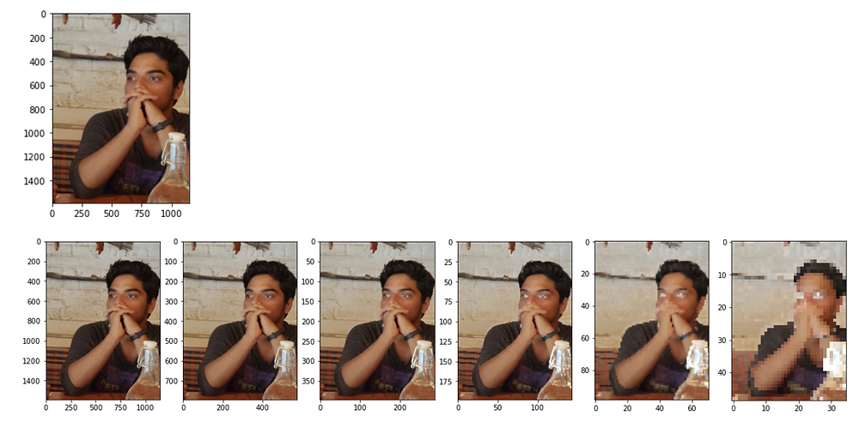
Higher def -------→ Low def

Slide 35
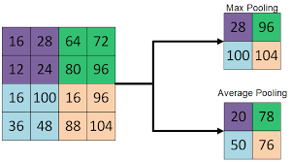
Pooling Types
Pooling is a simple concept – we take a set of pixels and reduce it to one pixel.
Pooling size defaults to 2 x 2.
Common pooling techniques:
Max pooling – the output value is the max of the pool values.
Average pooling – the output value is the mean.
What’s the difference?
Max – better at extracting contrast, e.g. foreground/background.
Average – smooths sharp features. Captures more info distributed across the entire image.
Max is used the majority of the time in our scope.
Note: size recommendations can scale up with larger models.

Slide 36
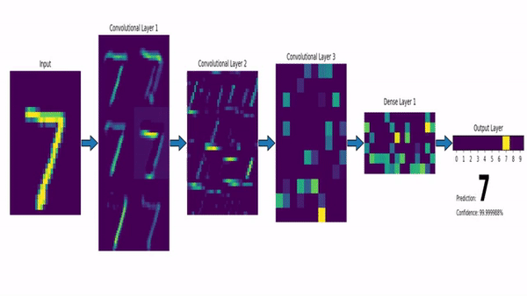
Pooling Visualized
There’s pooling between the layers.
Each layer is more generalized.
Less like image, more like ‘values’.
Creates feature from images.
Funnels the info…

Slide 37
We only kinda Know how NNs work…
"But I have to admit, I think the main reason people use max pooling is because it's been found in a lot of experiments to work well, ... I don't know of anyone fully knows if that is the real underlying reason.” -- Andrew Ng (a very smart guy who researches and teaches neural networks).

Slide 38
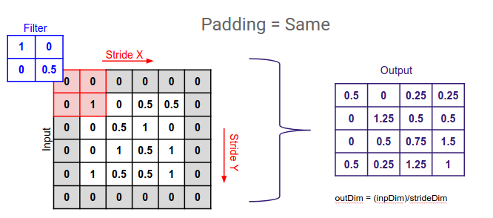
Padding
Padding determines what happens at the edge of an image.
The filter window can either:
Stop at the edge. Reduces dimension. Valid padding.
Go over the edge, filling in a border of 0s. Maintaining dimension. Same padding.
Padding does what we’d expect, better maintains information in the corners. (Border effects).

Slide 39
Batch Normalization
Batch normalization is a common step used in CNNs.
Standardizes the data between layers.
Sometimes added between convolution activation layers.
Requires disabling activation in the convolutional layer, adding it separately.
Shown to help performance in many cases.

Slide 40
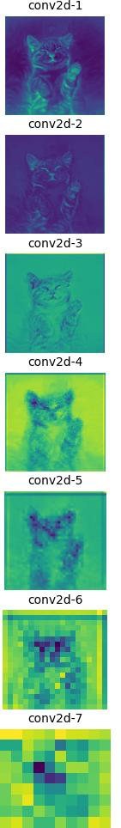
Stacking Layers
As data goes through layers, each one gets a ‘lower level’ representation.
Pooling layers will collapse a square of (usually) 4 pixels into one pixel.
Each layer “extracts a summary” of the layer above it.
At lower layers, the things are the same. These feed the DNN layers as the features.
Each set of filters will tend to learn different ‘objects’ in the image, and feed it to the DNN.
Objects can be made up of the several different low-level ‘objects’ found.
Some filters may end up learning to detect circles for the wheels.
Some filters may detect the edges for the body.
Lower-level filters may combine multiple objects in one – two wheels and some edges.
None of this is prescribed, but if a model has low loss by detecting a car, and cars are best detected by these characteristics, that’s where the model will eventually head.

Slide 41
CNN Back end – The Dense Part
After the convolutional parts of a CNN have extracted features, it is time to predict.
We flatten the data down and use a normal dense network at the end.
Overall structure:
CONVOLUTIONAL STUFF
Convolutional layer
Pooling layer
Repeat some combination of that a bunch of times, maybe with some normalization.
DENSE NETWORK
Flatten layer
Other stuff (hidden, dropouts, etc… If needed)
Output layer

Slide 42
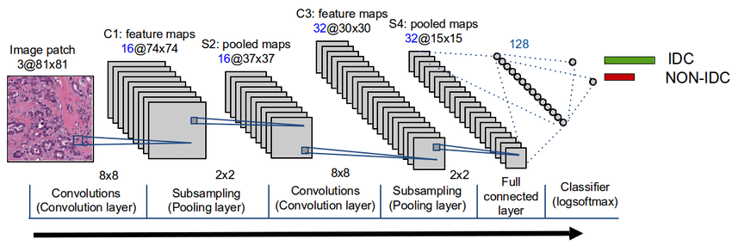
Convolutional Portion -> Dense Portion
The convolutional parts of a CNN normally repeat this through several layers:
Convolutional layer finds component image features.
Pooling layer generalizes.

Slide 43
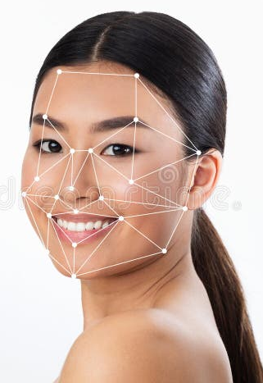
Image Preprocessing
We aren’t really doing it, but many real applications do more preprocessing.
This was even more common before models/computers were as powerful.
If you know exactly what you’re looking for, you can simplify for that.
Predefined process to get features you know you need.
There are lots of things that can be done, generally helping/replacing the ‘feature extraction’ bit at the top of a neural network.
Edge detection for a self-driving car.
The face shape-distance grid thing for facial recognition.
Circles to center on for aiming, like an industrial robot screwing bolts.

Slide 44
Datasets from Disk
In all examples until now our data has been entirely in-memory (system, not GPU).
When using a hosted dataset (e.g. minst), it is loaded directly into an array.
When using some file, we read the data from disk and load it into a DF or similar.
In many/most cases with neural networks we want/need to load data from disk.
The data is often too large to load into memory.
Keras provides dataset functions that create a dataset from folders on disk.
We aim it at the data on disk, and specify things like splits, and it does the rest.
There are different types – images, text, ‘from an array’, etc

Slide 45
Keras Datasets
To manage out of memory data we use tensorflow datasets to hold data.
A tf dataset is kind of a neural network specialized container of data:
It isn’t really meant for manual interaction – there’s no rows, features, etc…
We specify the batch size – the dataset will pull and provide data by batch.
We really just setup the parameters of where the data is and how to get it.
The dataset can also manage some of the ‘work’ on its own.
Processing like normalization, transformations, augmentation, etc… can be managed.
We can aim to have the CPU do prep while the GPU does training. (Later)

Slide 46
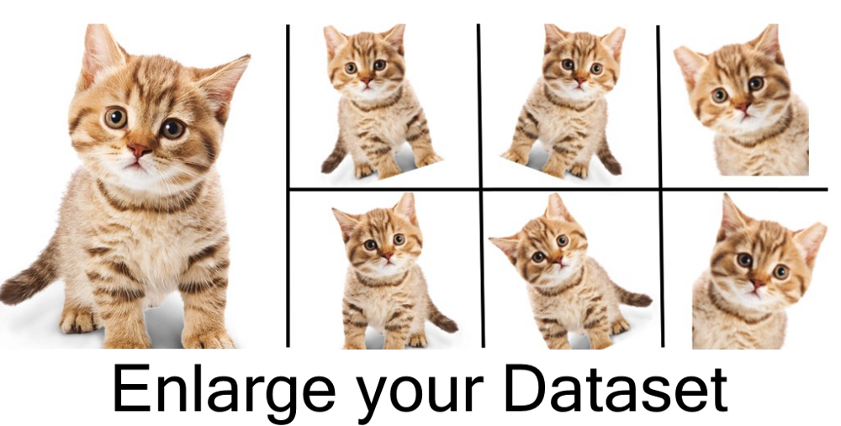
Data Augmentation
Recall the #1 rule of better predictions – get more data.
Images make it easy to generate more data for training.
Flip, shift, rotate, zoom, mirror, etc…
No matter which one of these manipulations we do, its still a useful kitty! As much as that can be true.
Easy to do when constructing a dataset.

Slide 47
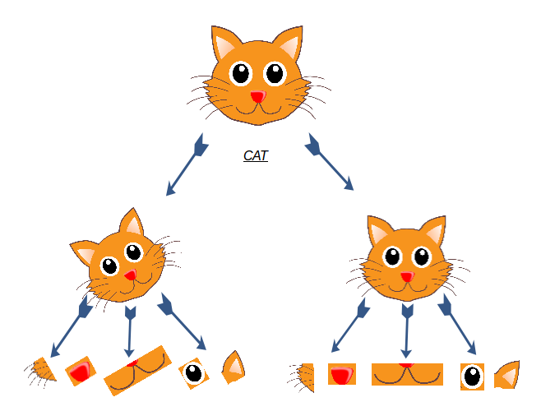

Slide 48
Real Life CNNs
CNN models are the way that image processing is done in most cases.
Modern image recognition models are very good, complex, and large.
Typically far beyond what is possible to train on consumer equipment.
Massive datasets are needed to train very large/complex models.
There are very few scenarios where training a model from scratch will win.
Only if the image data is very specialized, and we have a lot of it.
I.e. the less like identifying an object in an image the task is, the more likely we want to try.
We typically want to borrow and adjust a pretrained model if we want performance.
The generalized parts of “seeing” are common enough to transfer between problems.
We can repurpose the features found with convolution with our own classifier…

Slide 49
Pretrained Models and Transferred Learning
One common practice with images is to use and customize a pretrained model.
Images are large, datasets can be huge, processing is demanding.
Common filtering (kernels) is built in, since it has been trained with a lot of data.
E.g. edge detection is very important. Edges are a common feature that is extracted with image processing. Same with anything that is common across images.
Since CNNs can find characteristics anywhere in an image, it is very transferable.
Features are largely common across all images, not just ours, we can borrow that learning!
We’ll look at this more in ~2 weeks.
The feature extraction part of ‘see things in images’ is pretty hard to beat without insane computation.
‘Steal’ from the computationally rich and give to the computationally poor!

Slide 50
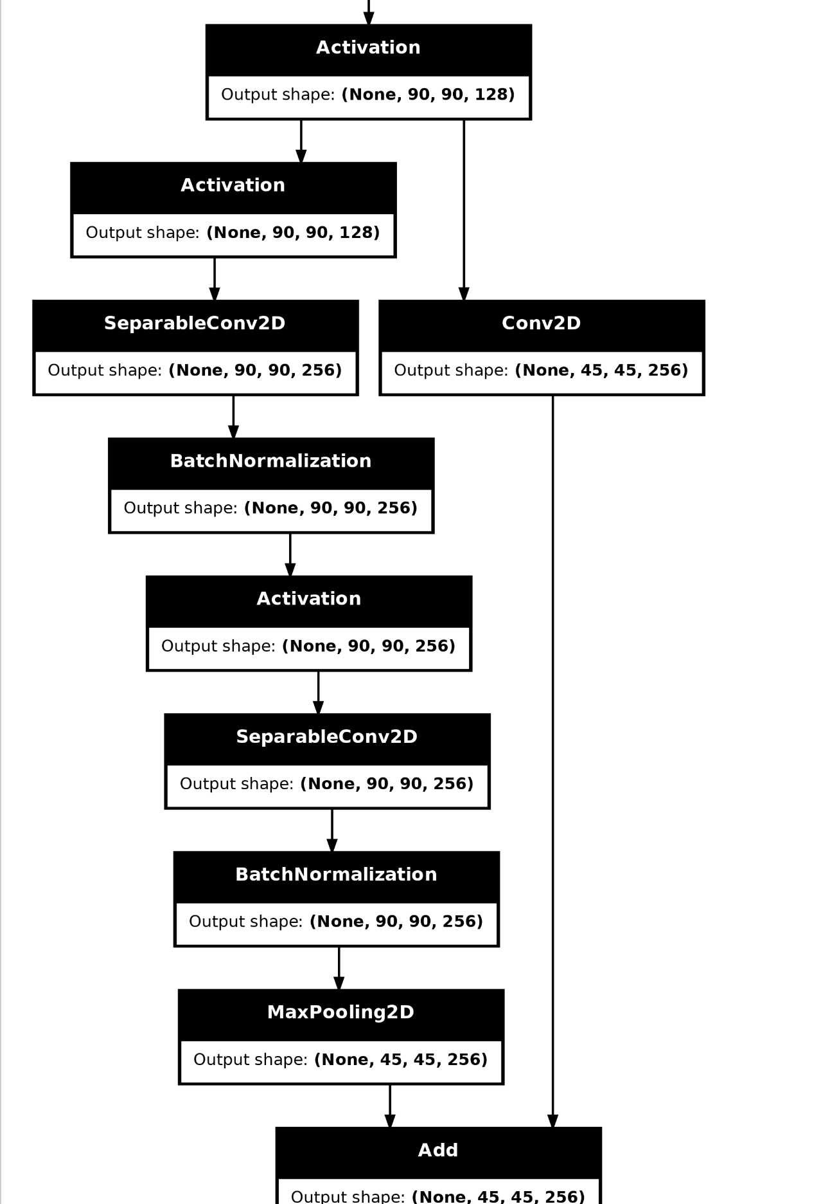
Does not need to be simple
The structure of the network doesn’t need to be simple.
More advanced models can do different things.
This is from one of the Keras examples.
Commonly – pass ‘non-convoluted’ data down to a further layer, along with the processed data.
Allows for the CNN to detect features at different levels/scales.

Slide 51
CNNs and Images
Convolutional networks will generally perform better on image data.
The spatial awareness of the conv. layers can ‘see' shapes better than a dense, flat model.
Convolutional networks often benefit from depth, big depth.
Each layer extracts a different set of features from the data, pooling summarizes.
Multiple representations allow for the network to identify components in an image.
Good models can be really deep, hundreds of layers or more – sometimes not sequential.
Tuning is a more open-ended, larger, and slower challenge.
Structure of the network can be far more variable – layers, pooling, kernels, padding, etc…
You can have lots of filters to be trained, and they need to see lots of stuff to be smart.
Data tends to be large – both per record and number of records.

